Slide 1
15 Step LLM Agentic RAG Framework
ISG CMT ISG Insurance DEx
2024

Slide 2
AGENDA
Use Case
Metrics Improved with RAG Agentic Model
Success Measurement
Design Architecture
Enhancements
NLG Parser for Gosu

Slide 3
AGENDA
Testing the Product
Questions
Answers

Slide 4
AGENDA
Updated Plan to Stakeholders
Design Document
Bluebolt Ideas for Java Integrations with Smart
Assistant
Conclusion of Algorithm
Precision
Accuracy
F1- Measure

Slide 5
Objective: To develop a Smart Assistant that can answer questions and generate responses based on rules and data from the Claims Centre. Components: Agentic RAG: For tagging data shared in JSON Excel. NLP for Data: Generating tagging and identifying entities. OpenAI Models (GPT-4.0): Improving performance using search and prompt tuning. Enterprise Data Management: Managing data points on the cloud. Machine Learning Models: Filtering data using ML algorithms for fine-tuning results.
USE CASE : Smart Assistant for Claims Centre
7 JAN ,2025

Slide 6
Metrics Improved with RAG Agentic Model

Slide 7
Optimize Queries: Ensure that your database queries are optimized for performance. Regular Backups: Implement regular backups to prevent data loss. Security Measures: Use Azure's security features to protect your data. Monitoring: Set up monitoring and alerts to track database performance and health. Scalability: Transition from Excel to a scalable database for better data management. Model Optimization: Continuously fine-tune models to improve performance and accuracy. User Feedback: Incorporate user feedback to enhance the Smart Assistant's capabilities.

Slide 8
Security: Implement robust security measures to protect data and ensure privacy. Documentation: Maintain comprehensive documentation for all components and processes.

Slide 9
Success Measurement Data Ingestion: Rules and data are ingested through the React.js application. Data Processing: Data is processed using NLP models and tagged using the Agentic RAG framework. Vectorization: Data is converted to vector format using Cosine Similarity and TF-IDF. Model Integration: Data is fed into machine learning models (Isolation Forest, Decision Tree, Random Forest, Bayes Algorithm) for analysis and response generation. Response Generation: Responses are generated using Generative AI models (GPT-4.0) and fine-tuned using prompt tuning. Data Management: Processed data and responses are stored and managed in the backend.

Slide 10
DESIGN ARCHITECTURE

Slide 11
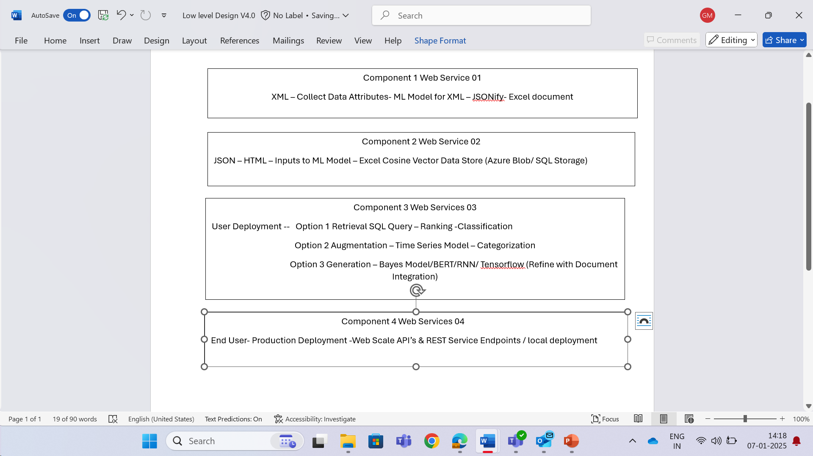


Slide 12
ENHANCEMENTS

Slide 13
NLP Models: For text processing and summarization.
RAG Framework: To retrieve relevant sections of the document.
Generative AI: For generating concise summaries.
Data Management: To handle document storage and retrieval.

Slide 14
NLG Parser for Gosu

Slide 15
Natural
Language
Processing
Agentic RAG: For tagging data shared in JSON Excel.
Enterprise Data Management: Managing data points on the cloud.
NLP for Data: Generating tagging and identifying entities.
OpenAI Models (GPT-4.0): Improving performance using search and prompt tuning.
Machine Learning Models: Filtering data using ML algorithms for fine-tuning results.

Slide 16
Bluebolt Ideas for Java Integrations with Smart Assistant
Self Autonomous Driving
Predictive Maintenance
Chatbots for Forecasting any Use Case
Energy Management for Green Design

Slide 17
REFERENCES GITHUB: madhurigopal

